Slide 1
Statistics Basics
By :- Ravi

Slide 2

Mean
The sample mean is the average and is computed as the sum of all the observed outcomes from the sample divided by the total number of events. We use x as the symbol for the sample mean.
In math terms,
where n is the sample size and the x correspond to the observed valued.

Slide 3
Median
One problem with using the mean, is that it often does not depict the typical outcome. If there is one outcome that is very far from the rest of the data, then the mean will be strongly affected by this outcome. Such an outcome is called and outlier. An alternative measure is the median. The median is the middle score. If we have an even number of events we take the average of the two middles. The median is better for describing the typical value. It is often used for income and home prices.
The mean is influenced by outliers while the median is robust.

Slide 4
Mode
The mode identifies the most common value or values in the data set. Depending on the data, there might be one or more modes, or no mode at all.
Suppose data is - 20, 22, 23, 24, 25, 25, 36
- the mode is the value 25

Slide 5
Range
Range shows the mathematical distance between the lowest and highest values in the data set. Range measures the variability of the data set. A wide range indicates greater variability in the data, or perhaps a single outlier far from the rest of the data. Outliers may skew, or shift, the mean value enough to impact data analysis.
Suppose data is - 20, 22, 23, 24, 25, 25, 36
- Range => 36-20=16
The high data value of 36 exceeds the previous value, 25, by 11. This value seems extreme, given the other values in the set. The value of 36 might be an outlier data point.

Slide 6
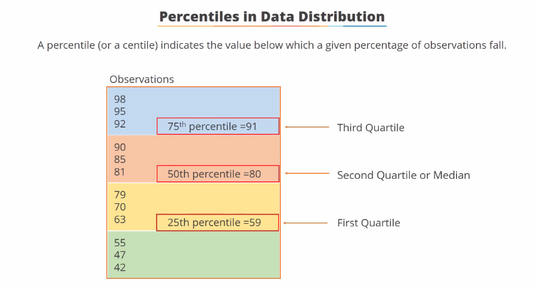

Slide 7
Variance and Standard Deviation
Standard deviation is a measure of dispersement in statistics. “Dispersement” tells you how much your data is spread out. Specifically, it shows you how much your data is spread out around the mean or average. Its symbol is σ (the greek letter sigma)
The formula is easy: it is the square root of the Variance.
Variance
The variance, s², is used to calculate how varied a sample is. A sample is a select number of items taken from a population.
The variance is mathematically defined as the average of the squared differences from the mean

Slide 8
Formulas
Variance and Standard Deviation: Step by Step
Calculate the mean, x.
Write a table that subtracts the mean from each observed value.
Square each of the differences.
Add this column.
Divide by n -1 where n is the number of items in the sample This is the variance.
To get the standard deviation we take the square root of the variance.

Slide 9
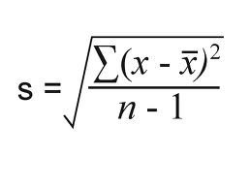
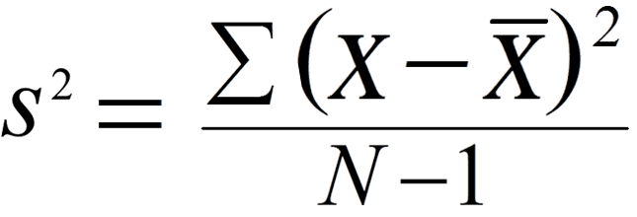
Formulas
Standard Deviation
Variance

